Slide 1
Bangabasi Morning College
DEPARTMENT OF ZOOLOGY
Topic
Somatic Cell Nuclear Transfer process of cloning
ADRIJA PAL
Sapna prasad
Monisha Dutta
Ankan Paul

Slide 2
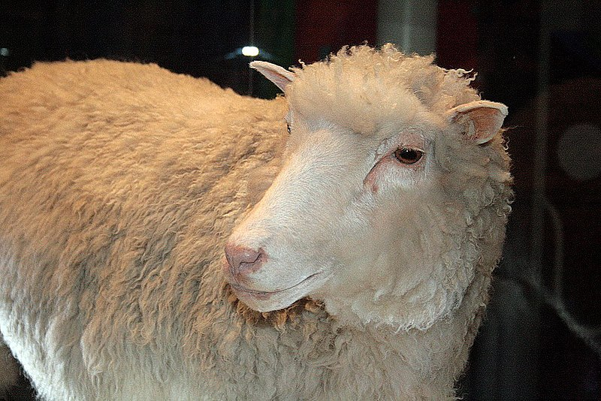
Introduction
Cloning describes the processes used to create an exact genetic replica of another cell, tissue or organism.
somatic cell nuclear transfer is a process of cloning in which nucleus of a somatic cell is transferred to cytoplasm of an enucleated egg.
SCNT was successfully used in 1996 to create the clone sheep dolly.

Slide 3
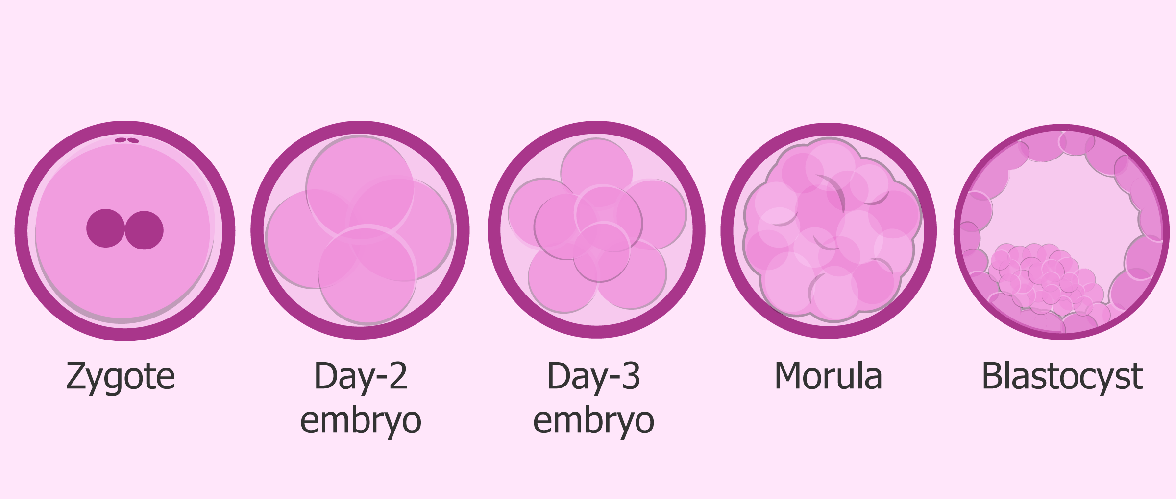
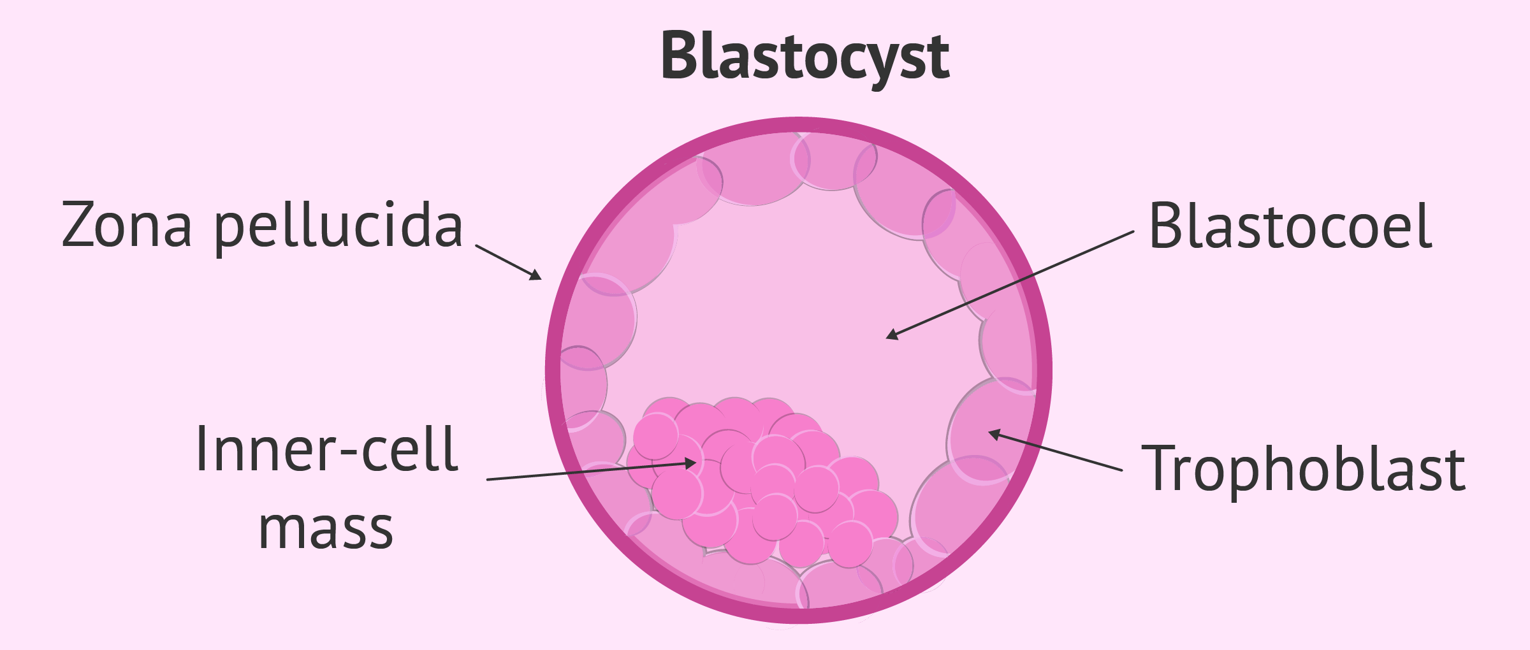
Somatic cell is not able to form a complete individual because its not totipotent.
Enucleated egg has certain cytoplasmic factors that motivate the nucleus of somatic cell to become totipotent and convert into zygote.
The blastocyst stage is developed by egg which it helps to create embryonic stem cells (ESC) from inner cell mass (ICM) of blastocyst.

Slide 4
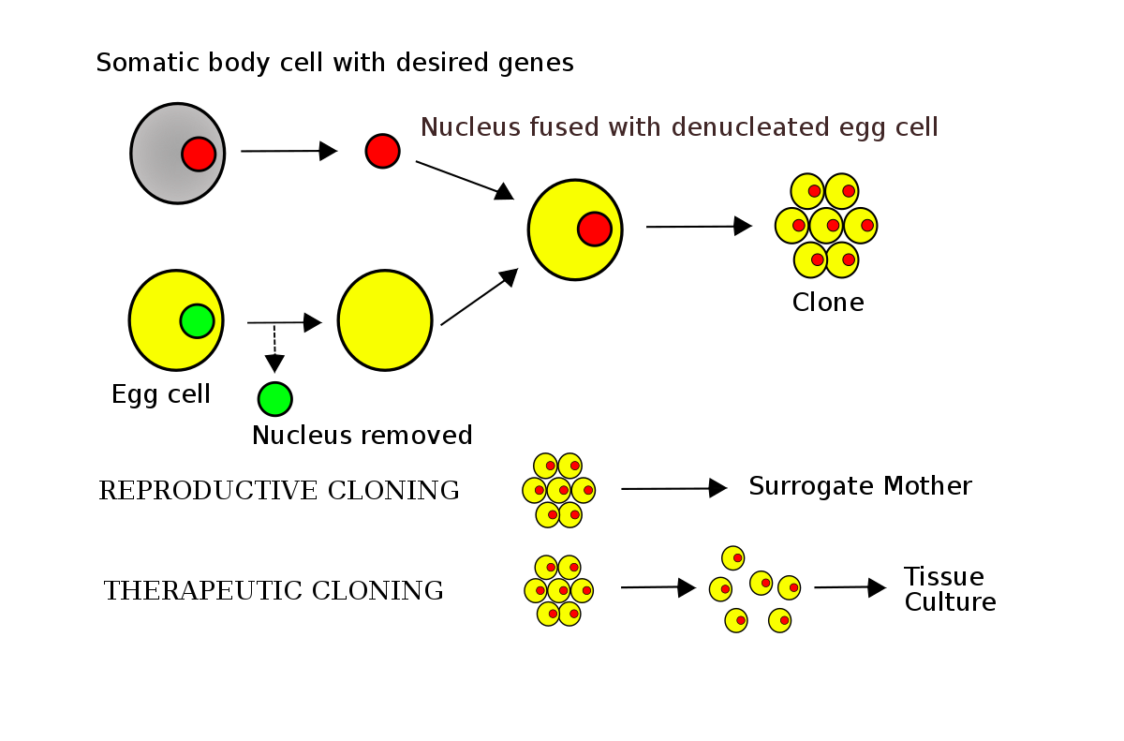

Slide 5
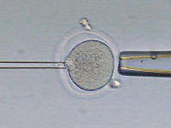
PROCESS
Cell selection: The somatic cell that will be used for cloning is selected and prepared for transfer. This cell can be obtained from various sources, such as skin cells.
Enucleation: The egg cell that will be used for cloning is obtained from a female donor and its nucleus is removed, leaving behind an empty egg cell. This process is called enucleation.

Slide 6
Nuclear transfer: The nucleus of the somatic cell is transferred into the enucleated egg cell using a small needle. The needle is used to puncture the egg membrane and the nucleus is inserted into the egg cytoplasm.
Fusion: After the nucleus has been transferred, the egg and the somatic cell are fused together. This can be done using electrical or chemical methods.

Slide 7
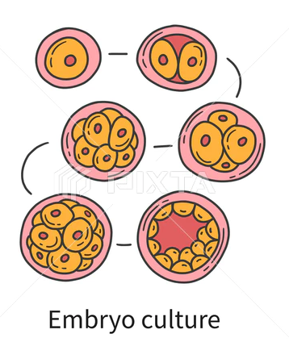
Activation: Once the egg and somatic cell have been fused, the egg is treated with chemicals or electric pulses to activate it and begin the process of cell division.
Embryo culture: The newly created embryo is cultured in the lab and allowed to develop for several days. If the embryo develops normally, it can be transferred to a surrogate mother for gestation.

Slide 8
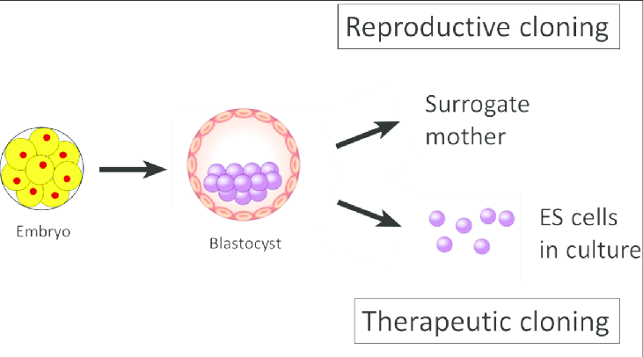

Slide 9
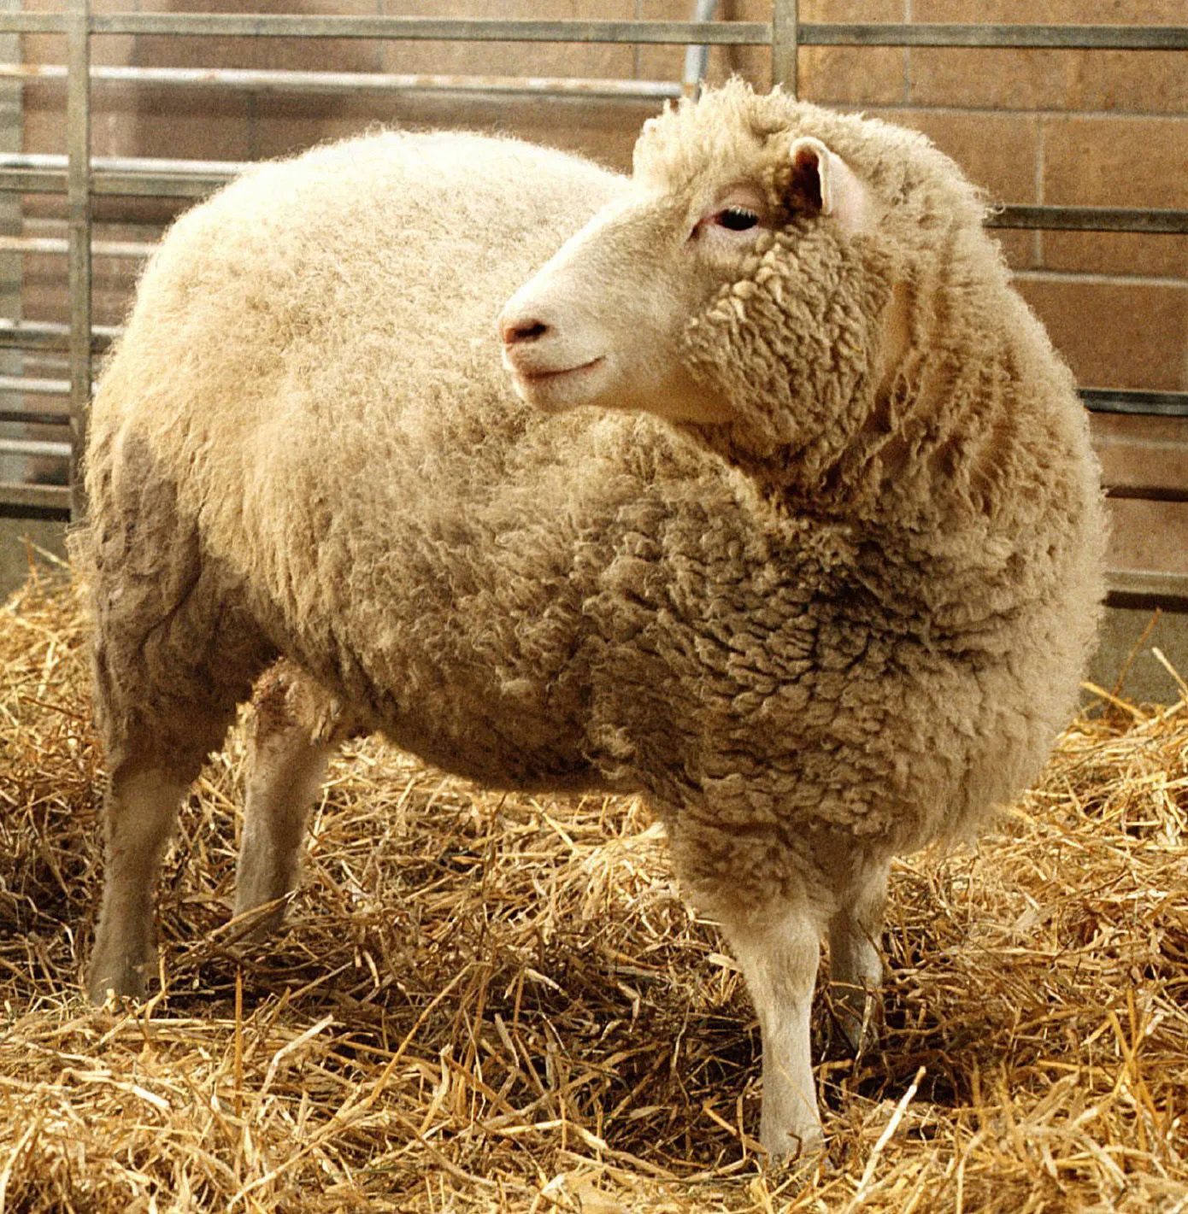
SCNT
REPRODUCTIVE CLONING
In reproductive cloning, the newly created embryo is placed back into the uterine environment where it can implant and develop. Dolly the sheep is perhaps the most well-known example.
The goal is to create a new organism human and other animal.
Reproductive SCNT is banned in most countries due to ethical dilemmas.
THERAPUTIC CLONING
In therapeutic cloning, an embryo is created in a similar way, but the resulting "cloned" cells remain in a dish in the lab; they are not implanted into a female's uterus.
the goal is to produce stem cells.
Theraputic SCNT is an important form of research.

Slide 10
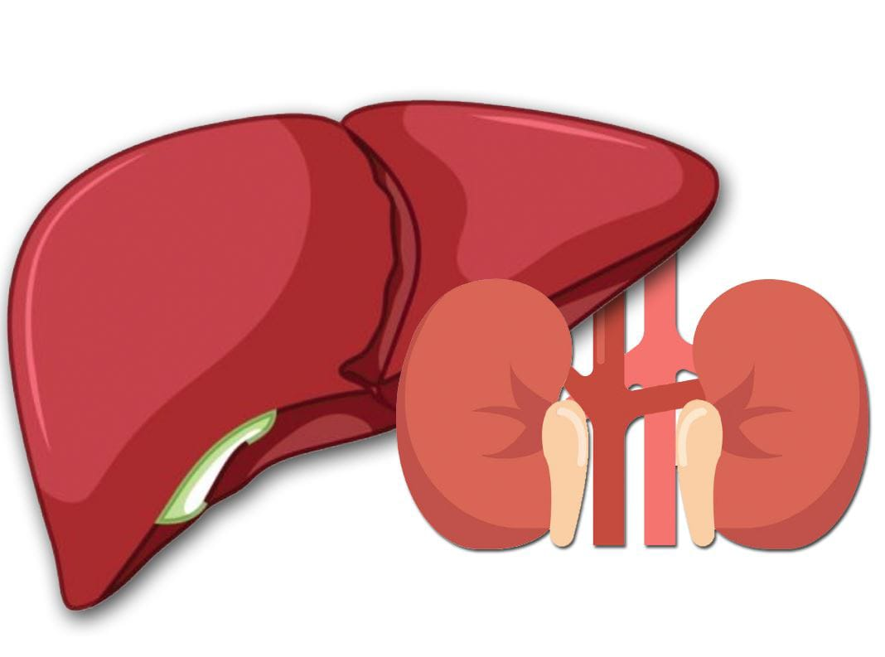
APPLICATION
SCNT can be used to create embryos of endangered species, which can be implanted into surrogates for reproduction or conservation purposes.
SCNT is used to create clones of animals for agricultural, research, and biomedical purposes. For example, cloned animals can be used as models to study human diseases or to improve livestock breeding.
SCNT could be used to create human organs for transplantation, reducing the risk of organ rejection.

Slide 11
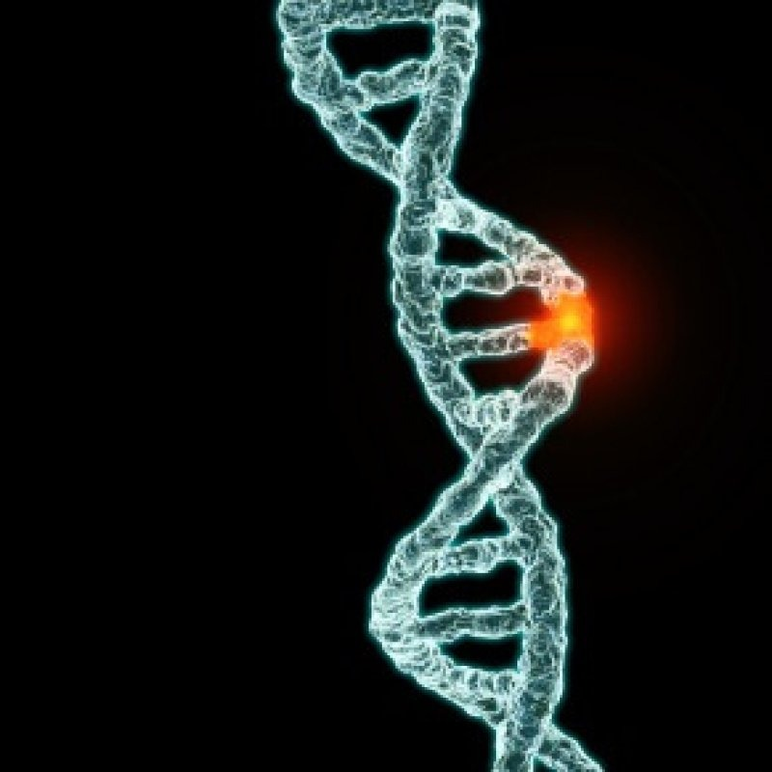
LIMITATION
Somatic cloning can only be done on mammals.
High percentage of clone dying when mother is pregnant.
About 90% of clones fail to grow.
Higher risk of genetic defects and abnormalities.
Higher risk of infection and disease.
Ethical issues behind cloning experiments.
Some of the wanted DNA is not transferred.

Slide 12
ETHICAL CONCERNS
Many believe that the use of somatic cell nuclear transfer in reproductive cloning defies the natural way of conceiving children.
Reproductive SCNT would devalue the genetic distinctiveness of each individual.
religious groups do also believe that the use of technology to create a human clone is against nature.

Slide 13
conclusion
SCNT (somatic cell nuclear transfer) is a powerful technology with the potential to create genetically identical embryonic stem cells for medical research and therapy.
However, its use raises significant ethical concerns, and there are still many technical challenges associated with the procedure.
Ongoing research in SCNT and related technologies will continue to shape the field of regenerative medicine and personalized therapy, but careful consideration of the ethical implications of this technology is necessary.

Slide 14
ACKNOWLEDGEMENT
We are very glad for getting the opportunity to present The Presentation on the mentioned topic and we would like to acknowledge everyone who helped us accomplishing the presentation successfully including my friends, Honorable Principle sir, faculty members and Head of the department, Dr. Sreejata Biswas ma’am whose help, guidance and suggestions made this a success.
Thanking You,

Slide 15
REFERENCES
https://en.m.wikipedia.org/wiki/Somatic_cell_nuclear_transfer
https://www.slideshare.net/techfreak101/somatic-cell-nucleartransfer
https://pubmed.ncbi.nlm.nih.gov/26621598/
https://www.ncbi.nlm.nih.gov/pmc/articles/PMC2726839/
https://www.frontiersin.org/articles/10.3389/fgene.2020.00205/full
https://www.sciencedirect.com/topics/biochemistry-genetics-and-molecular-biology/somatic-cell-nuclear-transfer

Slide 16
Thank You…

